Slide 1
A System for Predicting Stock Price and Offering Financial Advice
by
Aadhar Agarwal, Jose Luis Amador Jaime, Leung Ka Wing, Luk Yin Chai
DL3
Advised by Prof. Dik-Lun, Lee

Slide 2



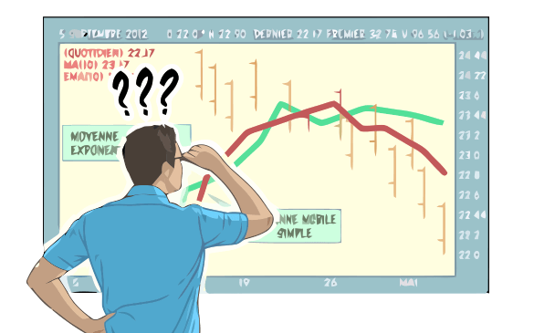
Introduction: Traditionally investing could only be done by skilled experts Better technology led to increased accessibility Online investment, stock prediction, automated services
However, investor still doesn’t have insight
GOAL; build a web application that offers financial advice based on stock price prediction.
Help people without financial knowledge benefit from stock investment through ML

Slide 3
Data

Slide 4
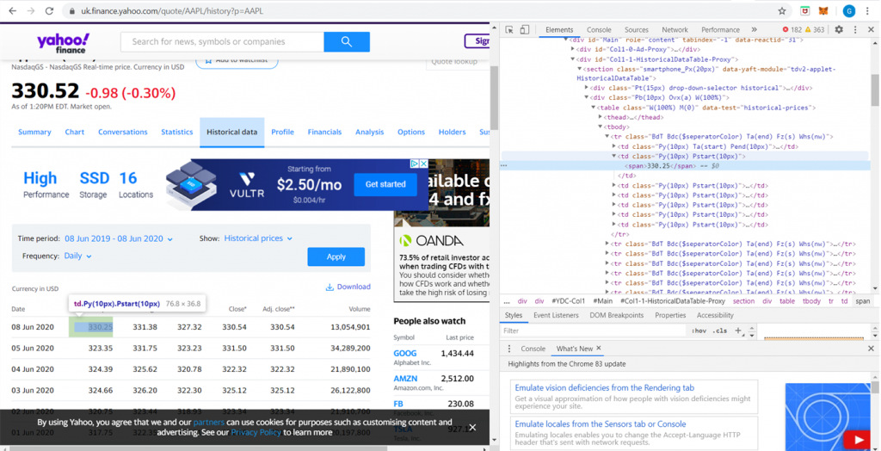







Datacrawler and Data APIs
Yfinance for crawling HK stock data
Adjusted close prices
Alpha Vantage API for fetching US stock data
Adjusted close prices
Simple Moving Average
Relative Strength Index
Data Crawler
Frontend
Server
Database
Investment Algorithm
ML Models

Slide 5
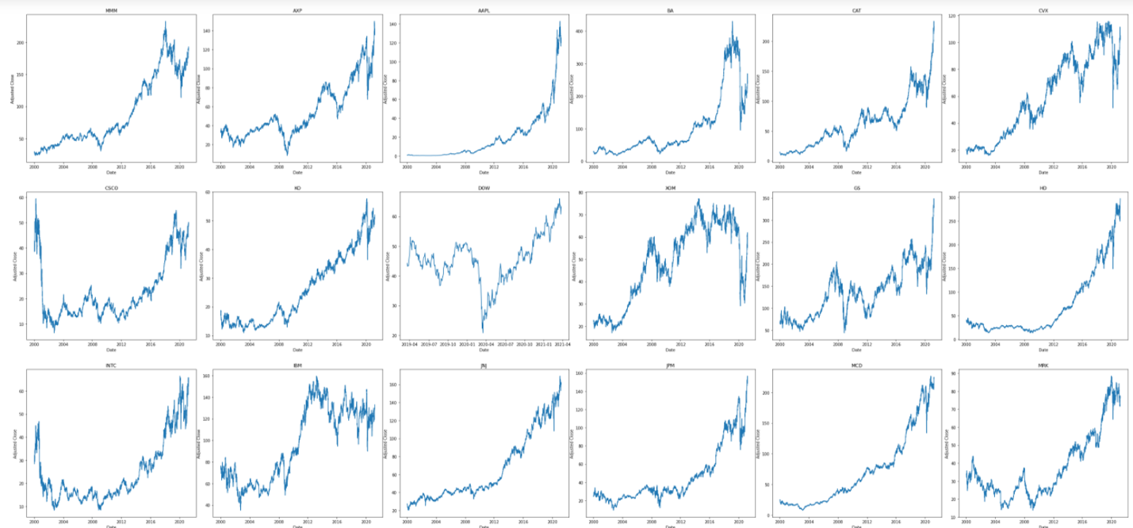
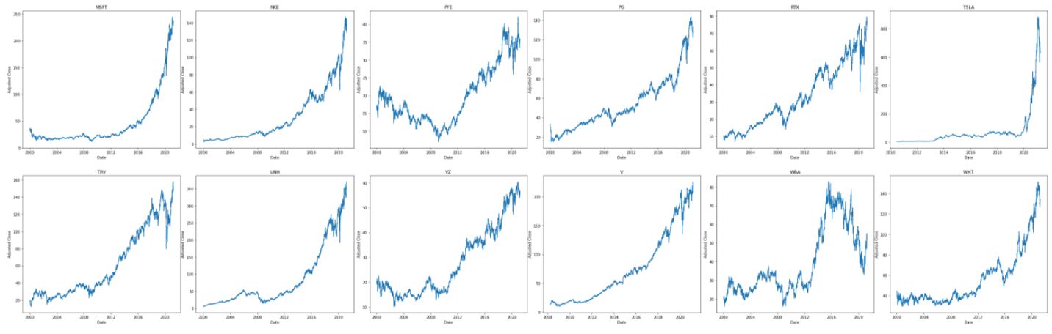
Dataset
Stock data from 12-Jan-2000 to 25-March-2021
Dow Jones Industrial Average stocks (30 stocks) with adjusted close price, relative strength index and simple moving average and more (5334 rows x 10 attributes)
HKEX stocks with close price, high, low and more (5203 rows x 5 attributes)

Slide 6
Stock Prediction
Using Machine Learning Models

Slide 7
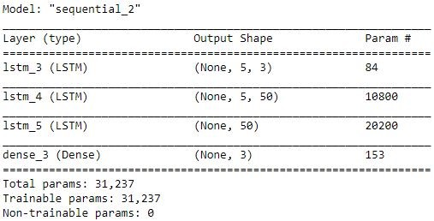
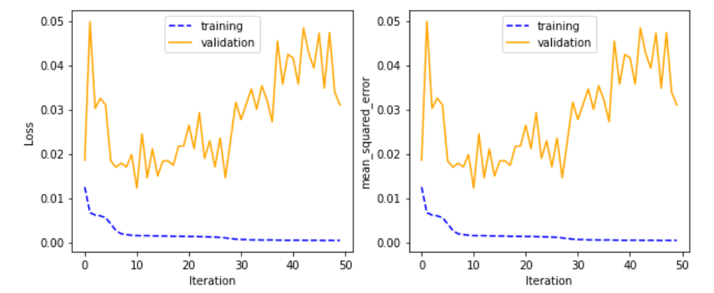
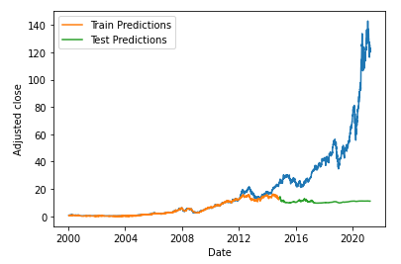
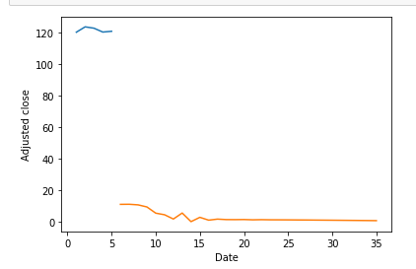
Multivariate RNN:

Slide 8
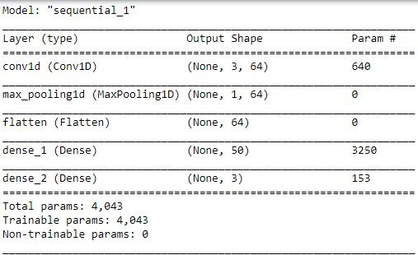
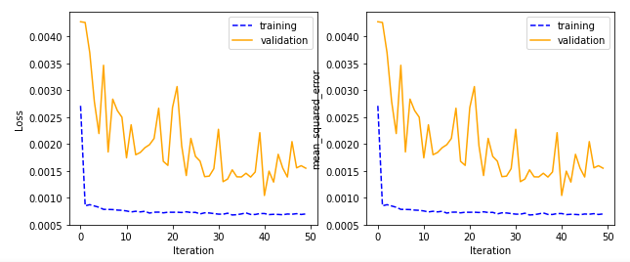
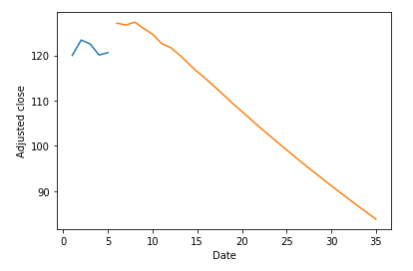
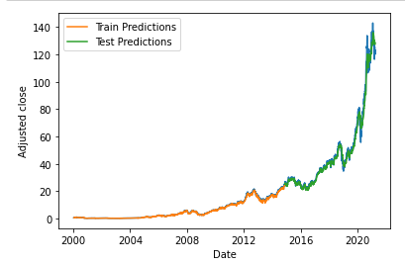
Multivariate CNN:
Lower MSE
Smoother forward prediction
MSE decreasing trend(No overfitting)

Slide 9
Portfolio Optimization

Slide 10
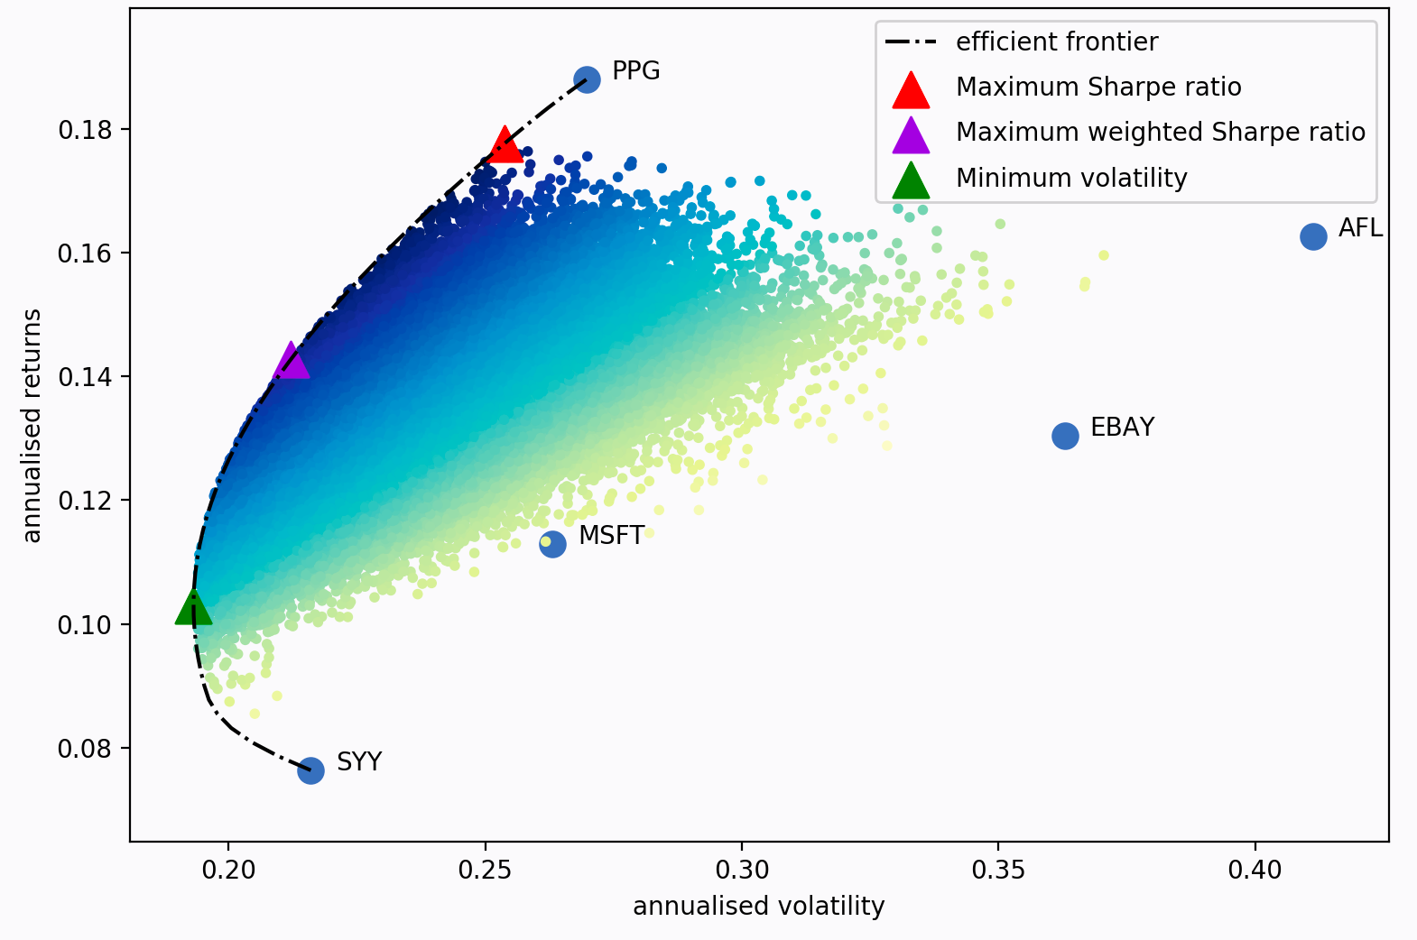
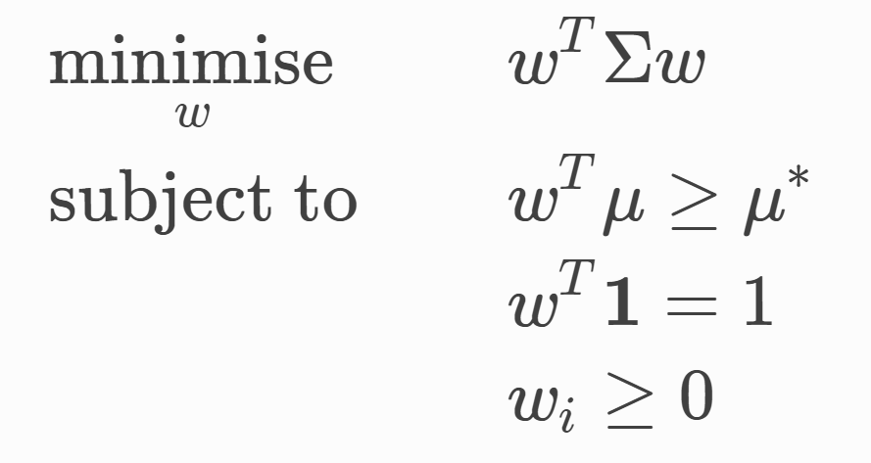
Mean Variance Optimization
Portfolio Optimizaiton is a convex optimization problem
The mean μ is the average return of a stock
The variance Σ is the covariance matrix of all stocks
And μ* and w^{t} are the target returns and total weights

Slide 11
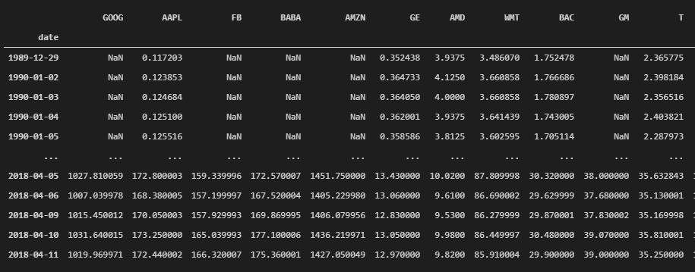
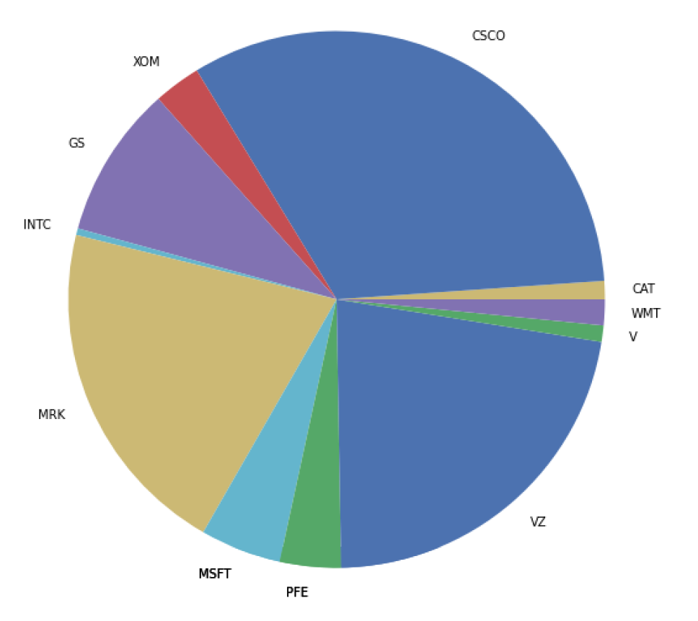
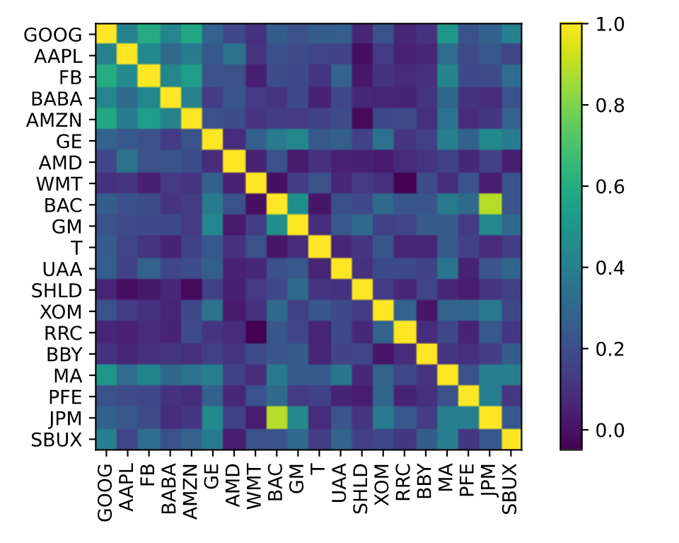
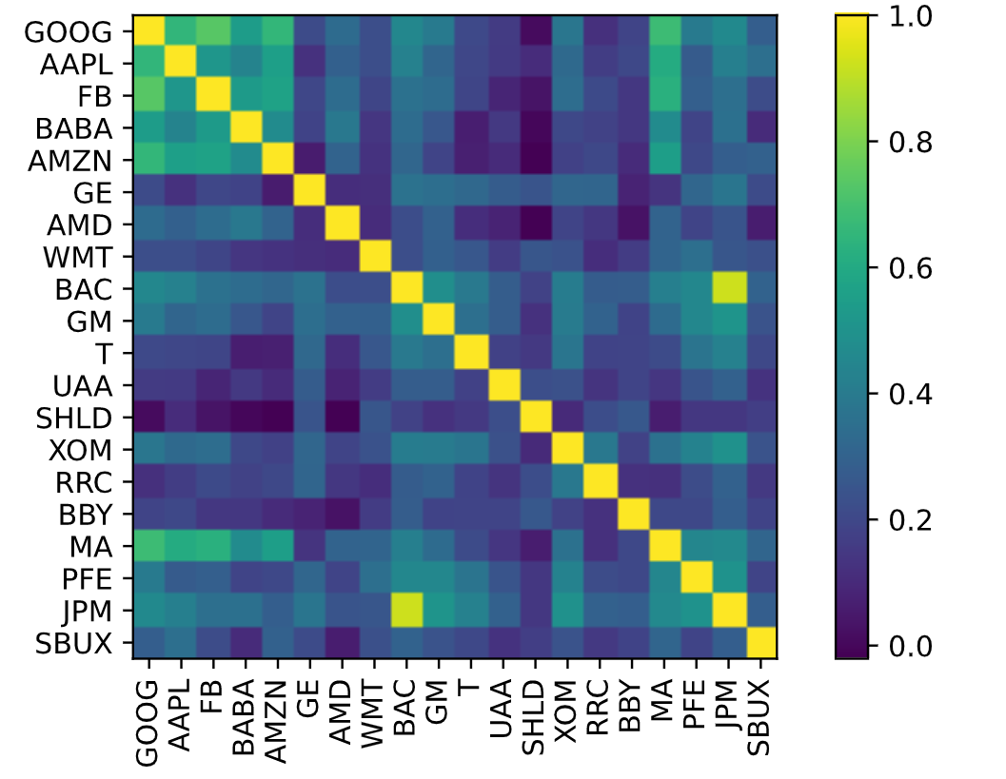
Using the Predicted prices

Slide 12
User Interface

Slide 13
